Slide 1
Library Loans

Slide 2
Our School Libraries
We are very lucky to have both an Upper and Lower school library!
All children are allowed 1 book on loan from the library at a time. You will need to return this book before you borrow another one.
Any one is able to borrow books from Mrs Healy’s shelf. You can see these books on reading cloud and reserve them OR talk to your teacher or Mrs Swanwick to get permission to visit the shelf with an adult during break time.
Y3/4- Borrow books from Lower Library
Y5/6- Borrow books from Upper Library. If you would like to borrow a book from Lower Library, speak to a librarian.

Slide 3
Our School Libraries
Your class teacher will let you know when you have time in lessons for you to change your book. This may be every other week so to help you change your book weekly, the Lower and Upper Libraries are also open at break time. Your class teacher will have a timetable to let you know when you can visit.
At break times, librarians will be available to help you if you aren’t sure which book to pick.
Please only visit the library during your allowed time so that it doesn’t become too busy.

Slide 4
Library Conduct
Bring your library card
Your class teacher will give you your library card. This may be kept in class, stuck in your reading record or stuck in your planner.
You cannot take out a book without your library card. You will not be allowed to tell the adult your code as this can lead to books being given out to the wrong borrower.

Slide 5
Library Conduct
Return your book to the library
When you visit the library, you will see the ‘Returns’ box. If you are visiting at break time, there may also be a librarian who can return your book for you. Librarians will also come round during the week to collect overdue books.
Please do not put the book back on the shelf- this will look like the book is missing and you may be charged if we cannot find it.
Please do not lend the book to another child. Once it has been returned, they can borrow it themselves.

Slide 6
Library Conduct
Quiet voices at all time- most of the time in the library should be silent
Choose your book quietly- children are likely to be working nearby.
Libraries are also places that people often go to do work. It is important we practise moving quietly round our library so you understand what is expected when you visit other libraries outside of school.

Slide 7
Library Conduct
Leave the books in the same condition and place you find them
We want you to look at and check the blurbs of books before you borrow them. Books need to be returned back to the correct shelf if you are not going to borrow them.
Books should be placed back onto the shelf to ensure they are not damaged. If you need help, ask a librarian.

Slide 8
Library Conduct
Look after our books
We are very lucky to have so many books in our library. We would like as many children as possible to enjoy each book so please look after them carefully. Please use a bookmark to keep your place rather than folding the page.
If a book is damaged, please let an adult know so it can be repaired. If it cannot be repaired, you may be asked to pay for a replacement.

Slide 9
How to use the library in school
In our school libraries, you will see Book Tree displays on the walls to help you. These displays show what books you may like to try next based on a book or author you have enjoyed recently.
You will also see a display of author names. These names are some of the most popular authors that children borrow in our school so you may wish to try these.

Slide 10
How to use the library in school
Fiction books are organised alphabetically by an author’s surname
For example:
David Walliams- You would need to look for ‘W’
Rick Riordan- You would need to look for ‘R’

Slide 11
How to use the library in school
Non-fiction books are organised using the Dewey decimal system. This is a set of number used to group books together that are about similar topics.
For example:
Books about Science- Look between 500-599
We have some guides in the library which can help you find specific topics and narrow down the numbers to help you find what you are looking for.

Slide 12
How to find a book- Online
Before you visit the library, you may want to browse to find some ideas for books you would like to borrow.
All children have access to Reading Cloud where you can search for books and see what is available to borrow.

Slide 13
How to find a book- Online
Log on to Reading Cloud
Go on our school website- Children- Library- Reading Cloud
These instructions will also be on the school website for you to use at home!
Our school postcode is WS5 3HF- You must have the right school in order to log on!

Slide 14

How to find a book
Search for the book you would like to read using the search tool.
You can search by author, book title or key word.

Slide 15
How to find a book
Select the book you would like to borrow by clicking on the title. You will then be able to see more information about the book including where it is located. This will help you know where in school the book can be found.

Slide 16
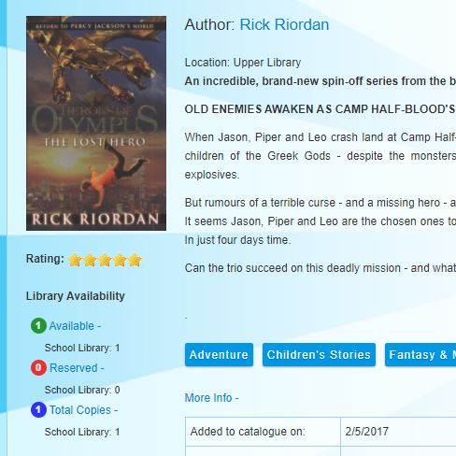
How to find a book
This book is located in the Upper Library
There is one copy available!
This is important- you may not be able to find the book if there are no copies available until it is returned.

Slide 17
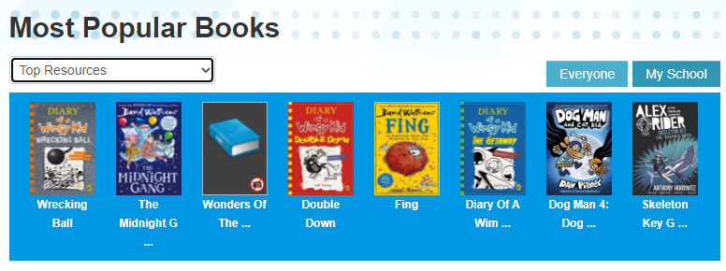
Other ways to choose a book- Top Resources
At the bottom of the home page, you can find some suggestions. Make sure you have selected ‘Our School’.

Slide 18
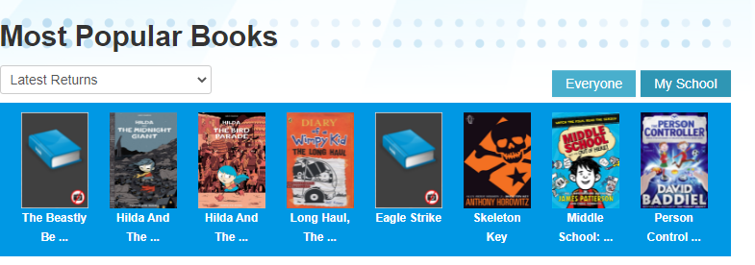
Other ways to choose a book- Latest Returns
At the bottom of the home page, you can find some suggestions. Make sure you have selected ‘Our School’.

Slide 19
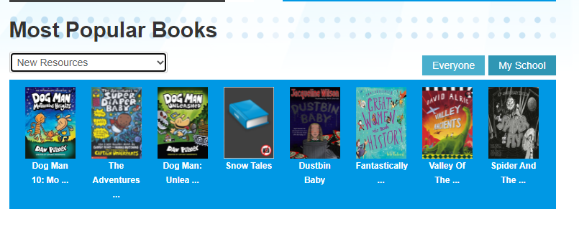
Other ways to choose a book – New Resources
At the bottom of the home page, you can find some suggestions. Make sure you have selected ‘Our School’.

Slide 20
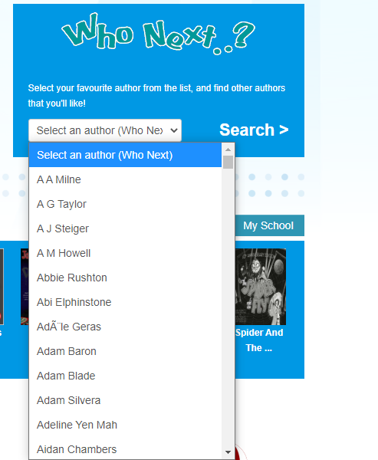
Other ways to choose a book – Author Suggestions
On the home page, you will also find a section where you can find new authors to try based on books you have already enjoyed.

Slide 21
How to request a book
If you want to request a book, you can press ‘Reserve’ next to the book on the library website. Please only make one reservation online at a time. It may take a while for your book to be given to you as our librarians are very busy! The quickest way to get a book is to visit at your designated break time.

Slide 22
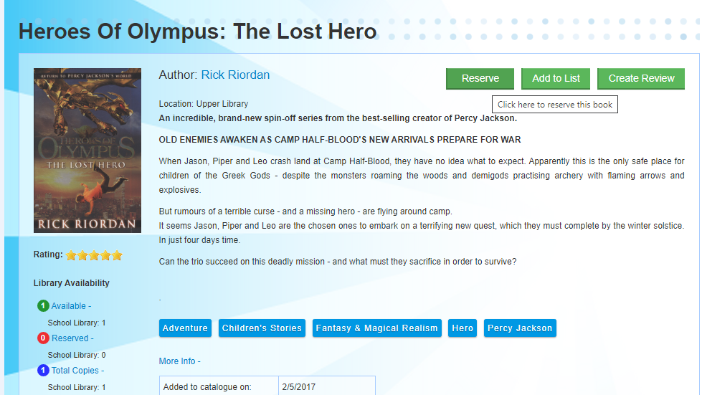
You can only reserve a book if a copy is available.

