Slide 1
Y6 Residential Visit 2025
Monday 14th July – Wednesday 16th July 2025

Slide 2
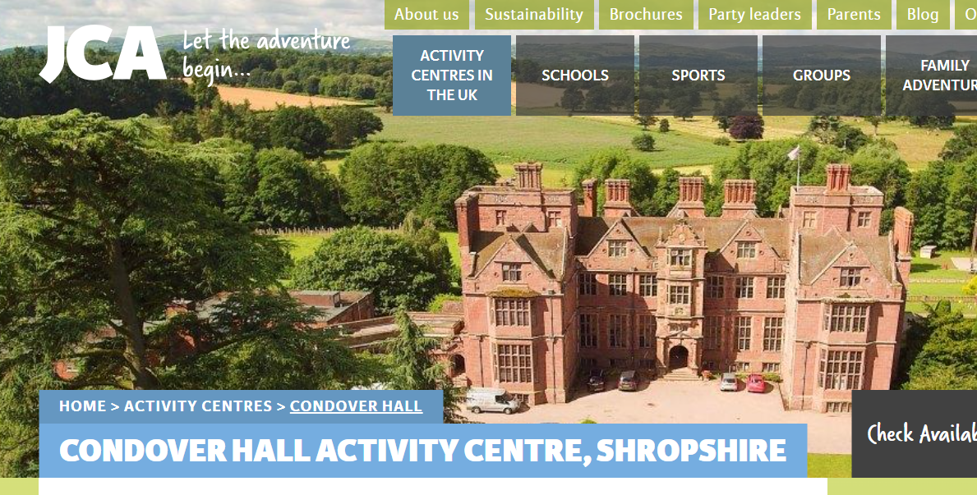
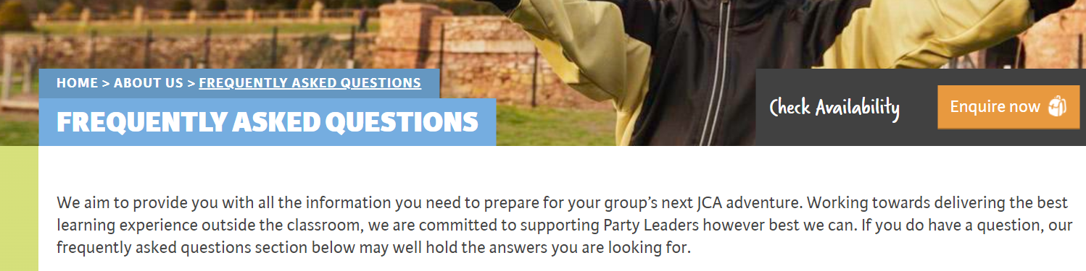
It would be useful for you to visit ‘JCA website’ to look in more depth at the FAQs.

Slide 3
Health and Safety
A Safety Management System is in place at our JCA activity centres, which has been externally inspected and verified with each member of staff trained to the standards depicted. This works alongside our Emergency Procedures Plan every member of staff must become efficient during their training.
JCA instructors hold the Health & Safety Executive Appointed Person award and carry a first aid kit for all activity sessions available to groups. A senior member of the JCA team with the First Aid at Work qualification is also present at each of our sites. Park Hall staff also carry First-Aid and any medicines children may require.
Thorough risk assessments have been carried out for all activities available to groups at our UK activity centres.
We work with a unique policy of one dedicated instructor per group for the duration of their stay.
Keeping up our high standards of quality learning experiences and safety during our residentials, we are recognised for the hard work we put in to continue to exceed the standards defined by the British Activity Providers Association (BAPA). As an accredited member of BAPA, we meet the high levels of quality, safety and value set for activity centres and residential providers.

Slide 4
Look for the red arrow. To give you an idea of the size of the setting, to walk that distance would be 15 minutes. Please ensure children have suitable footwear.

Slide 5

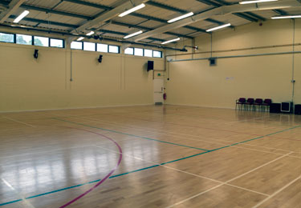
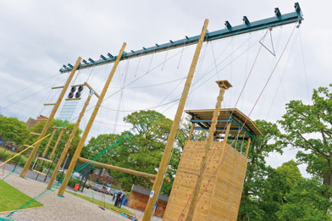
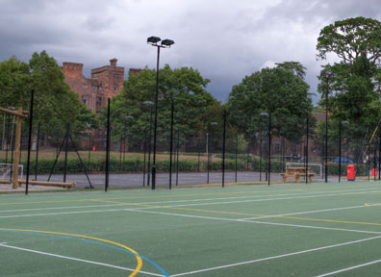
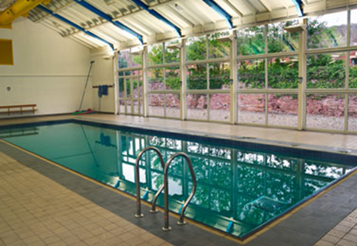
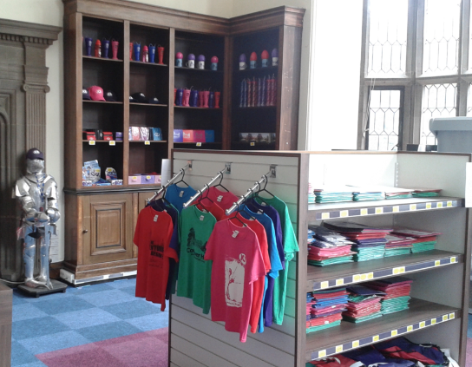
Facilities
Sports Courts
Sports Hall
High Ropes
Swimming Pool
Gift Shop

Slide 6
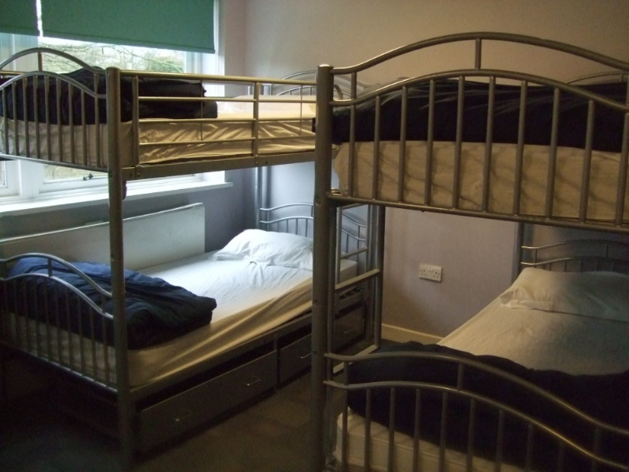
ACCOMMODATION
Comprises of multi-bedded dorms for students,
with bunk beds and ensuite facilities.
All accommodation blocks are set within a secluded and
secure area, yet still within easy reach of the main centre.
A JCA member of staff is on call 24 hours a day. In the evenings, Senior Staff are on duty until 11pm and patrol the grounds throughout the night from 11pm to 7am. Centre doors are secured in the evening but can be opened from the inside in case of emergency. Security barriers also guard the entrance to the site. All staff members are required to wear a uniform and name badges with a photograph, any visitors to the site are also required to sign in and wear visitor badges.
Park Hall staff will also check on children regularly in the evening and there are staff rooms and staff on every floor.

Slide 7
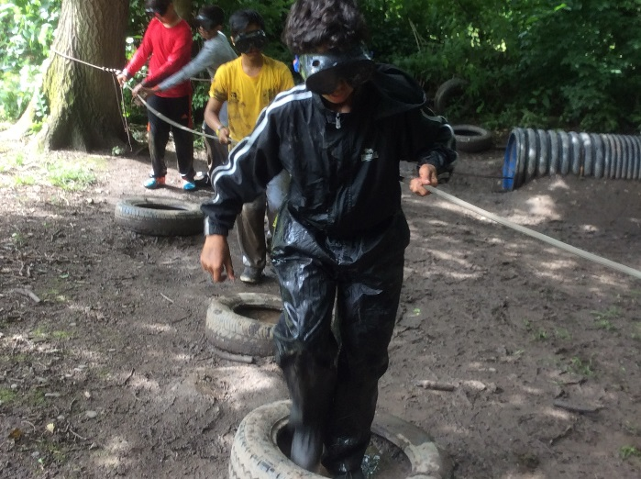
A selection of activities may include:
Abseiling
Aerial Trek
Climbing
Fencing
High Ropes
Initiative Exercises
Orienteering
Raft Building
Run Around Quiz
Sensory Trail
Sit on top Kayaking
Wet and Wacky
Wide Games
During your child’s stay, they will complete eight of the activities. One of these will include a water activity.

Slide 8
 | MORNING |  | AFTERNOON |  | EVENING
Sessions | 1 | 2 | 3 | 4 | 5
MONDAY | Travel to Condover |  | Intro Tour | Climbing | Egg Protector
TUESDAY | Raft Building/Sit on Top Kayak- Water activities |  | Abseiling | Orienteering | Runaround Quiz
WEDNESDAY | Archery | Awards | Travel back to school
An example itinerary has been outlined to show how the stay is structured. Each of the instructors are trained in all of the land-based activities. There will be a dedicated instructor per group.
For water sports, a separate instructor will be provided for this activity.
Each group time table is different - children complete activities at different points and / or at different times. Children will have their timetables so that they can organise themselves for the day.

Slide 9
Potential Daily Timetable
Breakfast - 7.30am to 8.30am
8.30am prepare your bag and clothing for the activity
SESSION 1 - 9.00am prompt -10.30am
Break - 10.30am to 10.45am
SESSION 2 – 10:45am prompt - 12:15pm
Lunch - 12.30pm to 1.30pm-
Remaining time is given for bag and clothing preparation for afternoon activity.
SESSION 3 - 2:00pm - 3:30pm
Break - 3.30pm to 3.45pm
SESSION 4 - 3.45pm to 5.15pm
Dinner - 5.30pm to 7.00pm
Time given to tidy room, pack bag (Tuesday)
EVENING SESSION - 7.30pm to 8.45pm
Back to accommodation, showering and bedtime routines.

Slide 10
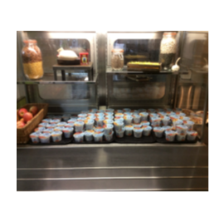
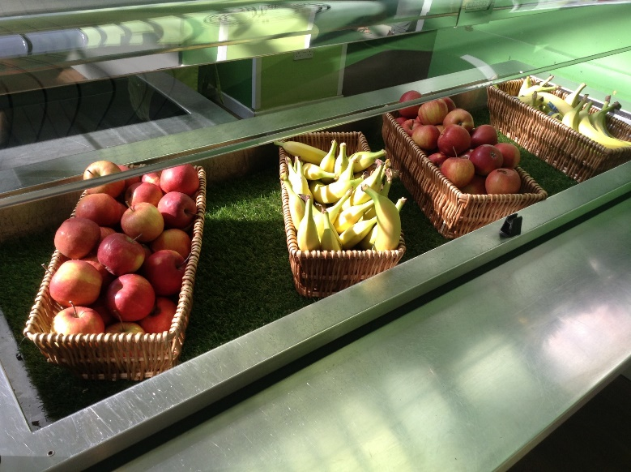
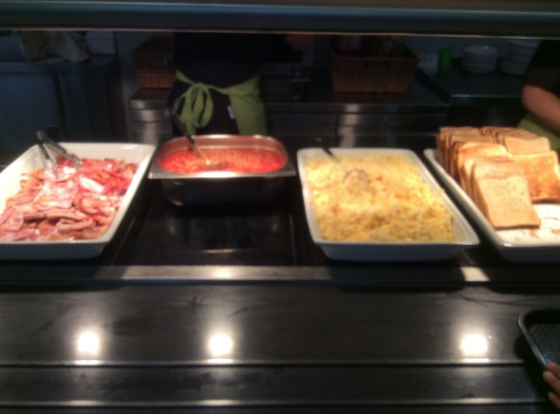
Breakfast options could be:
Sausage/vegetarian sausage
Scrambled eggs
Baked beans
Toast and jam
Croissants
Assorted cereals
A selection of seasonal fresh fruit OR fruit yoghurts
Squash or water
Special dietary requirements such as halal/
vegetarian/gluten free etc. will be catered
for.

Slide 11
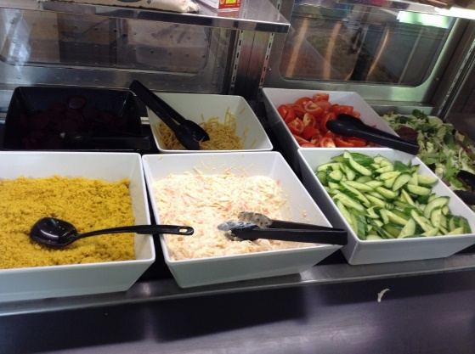
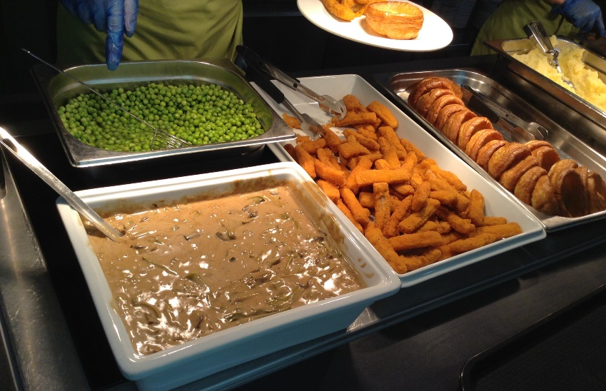
Lunch options could be: There will always be a choice of two to choose from as plus salad
• Jacket potatoes with different toppings
• Pasta (different sauces available)
Sausage roll/vegetarian alternative
BBQ chicken drumsticks and rice
Chicken nuggets/cod bites/battered vegetables
Mixed bean chilli
Salad bar/vegetables (corn, carrots, green beans etc)
A selection fresh fruit or yoghurts
Squash or water
Special dietary requirements such as halal/
vegetarian/gluten free etc. will be catered
for.

Slide 12
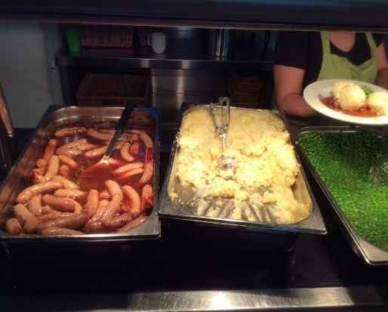
Dinner options could be: There will always be a choice of 3 to choose from.
Chicken curry/vegetable curry
Pizza
Pasta including macaroni cheese and vegetarian pasta bake
Burgers/vegetarian burgers
Fish and chips
Noodles
Wedges/fries/rice
Salad bar or peas/steamed vegetables
Cakes- sponge cake, doughnuts, cheesecake or ice cream
Squash or water
Special dietary requirements such as halal/
vegetarian/gluten free etc. will be catered
for.

Slide 13
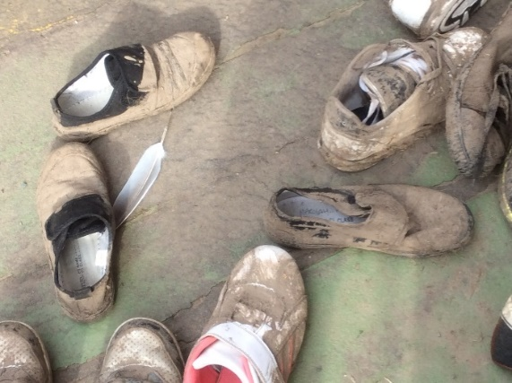
Key Points from Kit List
trousers/leggings (it’s important that the children do not wear jeans)
long sleeved top needed for some activities
jumper/sweatshirt/fleece
waterproof jacket/anorak
waterproof trousers or trousers that can get muddy/wet
shoes can get very muddy! Children must have 2 pairs of shoes - one of which is to be used in the kayaking/raft building. These will get wet!
all items named - including shoes! We have a lot of lost property every year
Cameras, watches and jewellery are brought at your own risk - the school will not be held responsible for loss or breakages. If you would like to take photos, we recommend bringing a disposable camera.
As you can see! Extremely muddy shoes!

Slide 14
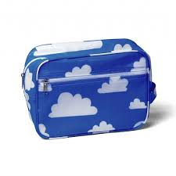
Toiletries
Toothbrush and toothpaste
Soap /shower gel
Hair products, i.e. shampoo/conditioner
Hair ties and brush – long hair must be tied back for some activities
Wash bag
Sun cream
Medication - named and given to group leader on arrival into school
For some activities, a helmet must be worn so hair must be tied back appropriately.

Slide 15


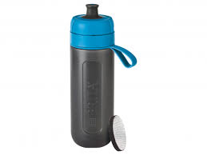
Other
Water bottle (a must)
Snacks - be mindful of nut allergies
Sunglasses
Book to read
Towel - for shower
Hat/cap
Swim kit, extra towel for water activities
Bag/bin liner for wet/muddy clothes to be put into
Spending money (can only be spent in the shop) no more than £10 in a named purse. This can be given to the group leader on arrival to school to look after.

Slide 16
Key Points from Kit List
Children are not permitted to bring the following items:
Straighteners/tongs or other heated hair appliances. Hairdryers are not provided and can be brought if needed
Smart watches including fitbits - these can get damaged when wet and muddy and adults cannot hold onto these items during activities
More than £10 - children will have 1 opportunity to visit the shop
Mobile phones/ any internet access devices
Electronic hand held gaming devices – a book is a good alternative!

Slide 17
Before the residential trip
Timetable/rooming - this will be sent to us by JCA in the days leading up to the trip.
Copies of the timetable will be posted in each room so children are aware of their activities and the timings.
Rooms – tend to be between 6-12 but this differs between different accommodation blocks. All rooms have a shower and toilet.
Groups – Children will find out their group closer to venture week. All children are guaranteed to be with someone from their choice list. A member of staff will be allocated to each group as a group leader. All Y6 teachers are attending Residential so children will have someone familiar they can speak to.

Slide 18
Arrival to school – Monday 14th July
Arrive at the normal time. Please come into school via the green gates and adults will be around to direct.
Suitcase/large bag will be taken to the hall and put with the child’s coach group - they will be told this group on arrival to school
Medication (must be named) to be given to staff on arrival to school. You may wish to put all medication inside a small zip lock bag
Children will keep their packed lunch/small bag with them in classes
Children go up to classes for registration and to complete activities until we leave later in the morning
Children will be responsible for taking their own suitcase/bag to the coach - a short walk away so they must be able to carry their own bags!

Slide 19
During the residential trip
School website will be updated with an overview of the day such as some of the activities and the food choices.
We will aim to update the website daily– the signal can be intermittent so please be patient.
We will take some photos and upload as and when the internet connection allows. As children do activities on different days, do not worry if you cannot spot your child doing a certain activity. By the end of the 3 days, all children will have taken part in all activities.
Any messages passed onto the school office will be shared with the group leaders as needed.

Slide 20
Return to school – Wednesday 17th July
Children will have a hot lunch at Condover
Following lunch, they will take their bags to the coach
Dependent on traffic, we normally arrive back mid-afternoon
Parents will be contacted and made aware of our arrival time. You will be able to collect your child early once they have arrived at school via the school office.
If children normally walk home, please make other arrangements for this day as they will have their bags with them and be tired! Please remember to book Treehouse if this is required.

Slide 21
Information you may wish to share with your child
Children will receive an assembly explaining the trip to them so they are aware of important information.
If children do feel unwell, staff members will look after them but they must let an adult know.
We can administer paracetamol, if permission has been given, as needed.
Staff will contact you if your child is unwell.
Medication will be looked after by group leaders who will make sure it is administered at the right time of day.

Slide 22
Information you may wish to share with your child
If children are feeling homesick, adults will look after them - this a normal part of being away from home.
If a child is upset and needs to speak to someone at home, we will make arrangements for them to ring and speak to you.
If you think your child may feel homesick, it is worth discussing with them about taking something from home that will comfort them. Many children bring a small stuffed toy - they will not be the only one!
They will be very busy! Nearly every part of the day is taken up with activities. There is very little ‘down time’ – it is a busy schedule.
JCA – FAQ - Part of the learning experience for each child is to adapt to being away from home. We would therefore ask that all parents allow their children to enjoy this experience unless contact is deemed necessary.

Slide 23
Information you may wish to share with your child
If your child is on their period, it may be worth getting them to share this with their group leader or another adult they feel comfortable speaking to if you think they would benefit from this.
We will have sanitary towels available if needed and all toilets have a bin.
For all activities, there are always toilets nearby. The lake activities are the furthest from a toilet, but, if needed, an adult will be available to walk children to the toilets.

Slide 24
Information you may wish to share with your child
If your child has an accident during the day or night, they just need to let an adult know. They will not get in trouble nor will the adult share this information with any other children.
We can take children back to get changed in their room as needed or request additional bedding from JCA. An adult would then change their bedding when other children are not in the room.

Slide 25
Information you may wish to share with your child
If your child is fearful of the dark, we will be encouraging children to leave a the bathroom light on in all rooms.
This will help children find the bathroom, in unfamiliar settings, and also helps children, who are on top bunks, climb down during the night.
Lights out will be around 10pm, dependent on the return from night time activities.
Staff will check on all rooms in the evening.
If a child needs an adult during the night, all adult rooms are clearly labelled and there will be adults on each floor.

Slide 26
Questions
We know that more questions will be generated from the information that has been shared.
If you have any further questions, please e-mail in or attend the drop in session
For questions received via email we will either contact you directly or send out an ‘FAQ’ based on questions received.
Should you require a 1:1 discussion about your child’s needs, please book an appointment through the school office.

